Slide 1
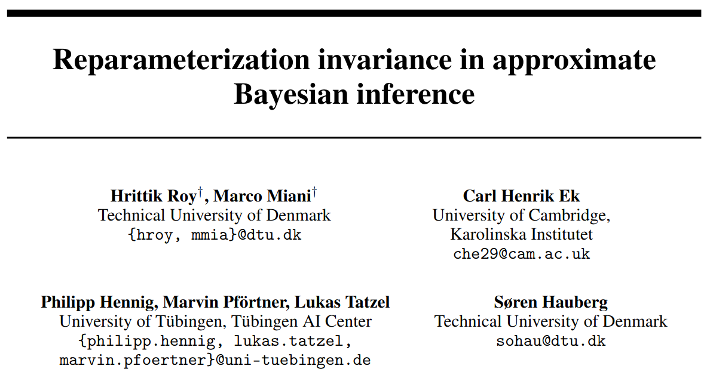
Why linearised Laplace > regular Laplace
October 2024

Slide 2




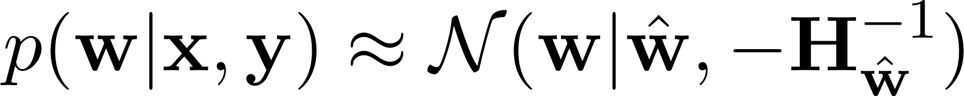
Section 1: Laplace Approximation in BNNs
Neural network with likelihood and prior
Take second-order Taylor expansion of log-posterior around a mode
Approximate posterior as
with Hessian matrix

Slide 3
Section 1: Laplace Approximation in BNNs
Neural network with likelihood and prior
Take second-order Taylor expansion of log-posterior around a mode
Approximate posterior as
with Hessian matrix

Slide 4
Section 1: Laplace Approximation in BNNs
Neural network with likelihood and prior
Take second-order Taylor expansion of log-posterior around a mode
Approximate posterior as
with Hessian matrix

Slide 5
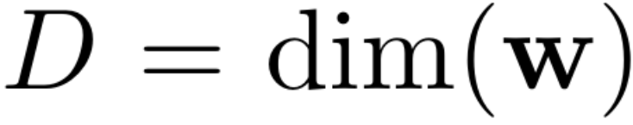

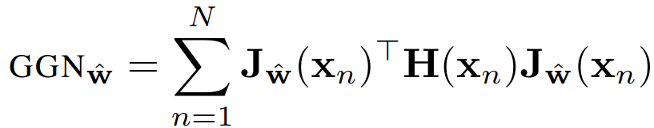
Linearised Laplace BNNs
Linearise the NN at
using Jacobian
Linearised Laplace approximation with prior gives

Slide 6
Linearised Laplace BNNs
Linearise the NN at
using Jacobian
Linearised Laplace approximation with prior gives

Slide 7
Linearised Laplace BNNs
Linearise the NN at
using Jacobian
Linearised Laplace approximation with prior gives

Slide 8
Linearised Laplace BNNs
Linearise the NN at
using Jacobian
Linearised Laplace approximation with prior gives

Slide 9
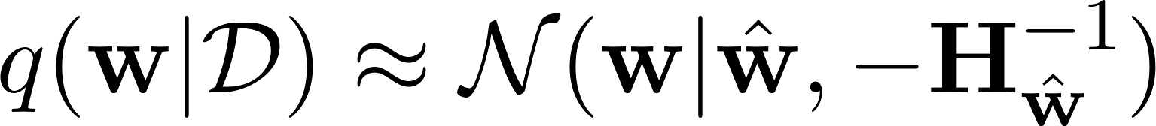
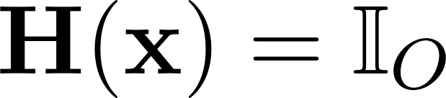
Laplace vs Linearised Laplace
GGN is commonly used to approximate the Hessian
Immer et al. (2021) argue that this choice implicitly linearises the BNN
(If likelihood is gaussian, then )

Slide 10
Laplace vs Linearised Laplace
GGN is commonly used to approximate the Hessian
Immer et al. (2021) argue that this choice implicitly linearises the BNN
(If likelihood is gaussian, then )

Slide 11
Laplace vs Linearised Laplace
GGN is commonly used to approximate the Hessian
Immer et al. (2021) argue that this choice implicitly linearises the BNN
(If likelihood is gaussian, then )

Slide 12
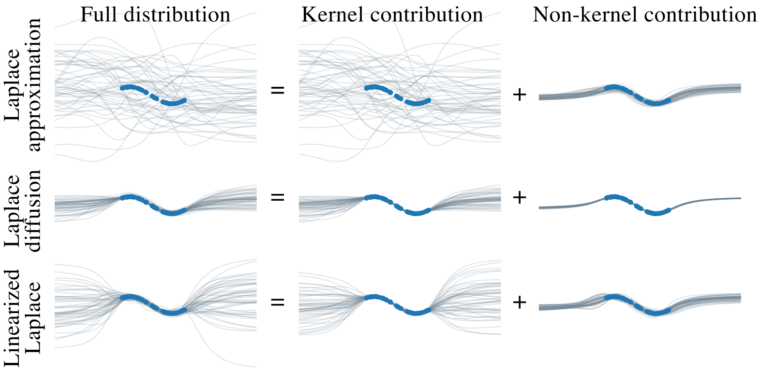
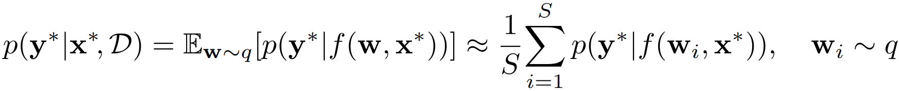
Predictive distributions
Regular Laplace severely underfits
Linearised predictions perform much better
Why does adding another degree of approximation improve performance?

Slide 13
Predictive distributions
Regular Laplace severely underfits
Linearised predictions perform much better
Why does adding another degree of approximation improve performance?

Slide 14
Predictive distributions
Regular Laplace severely underfits
Linearised predictions perform much better
Why does adding another degree of approximation improve performance?

Slide 15
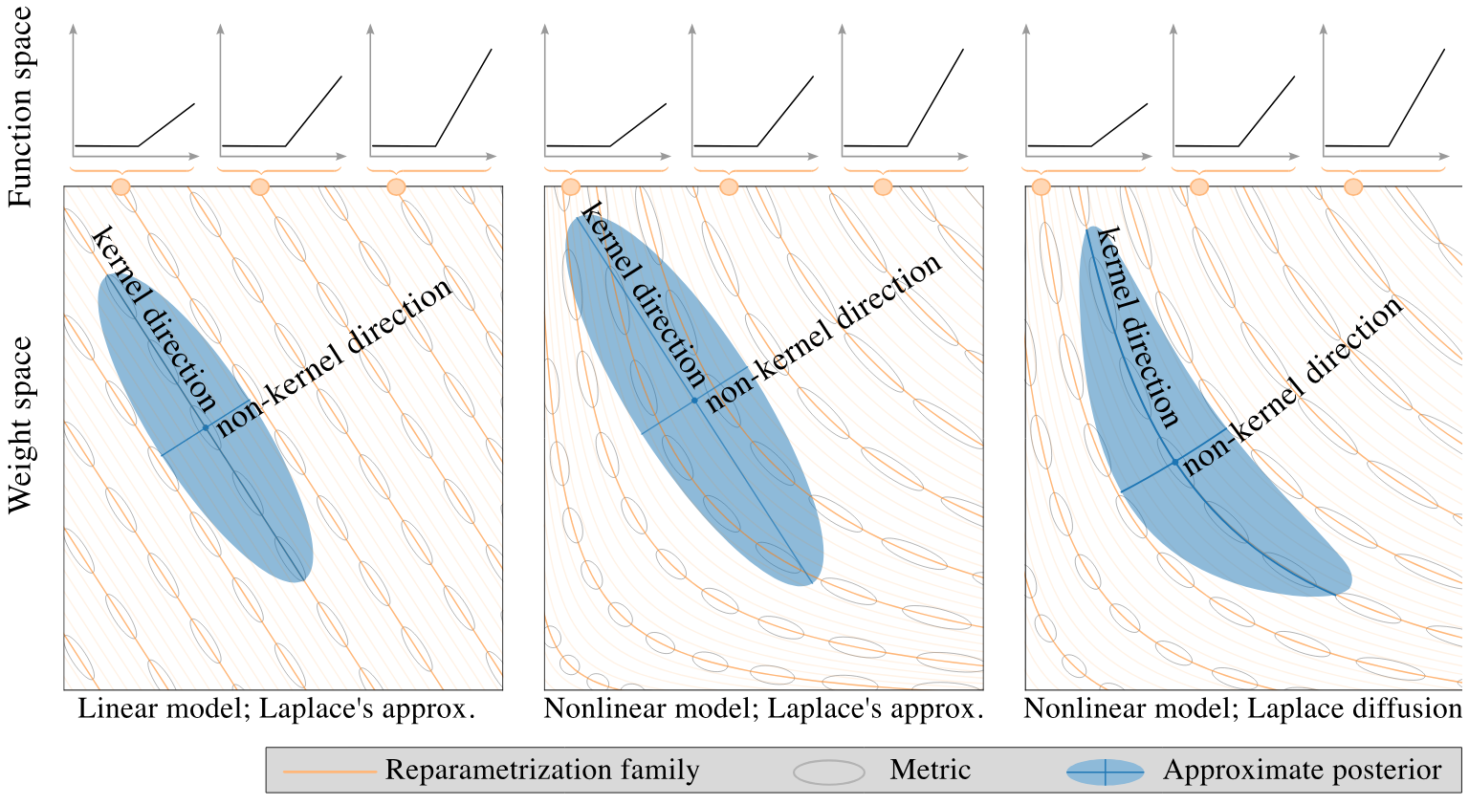



This paper: linearised laplace is better because it’s invariant to reparameterisation
BNNs are massively overparameterised, with many points in weight-space corresponding to identical functions
Consider the NN
For any , and are equivalent
The GGN covariance naturally aligns the linearised Laplace approx. post. with the reparameterisation (kernel) direction

Slide 16
This paper: linearised laplace is better because it’s invariant to reparameterisation
BNNs are massively overparameterised, with many points in weight-space corresponding to identical functions
Consider the NN
For any , and are equivalent
The GGN covariance naturally aligns the linearised Laplace approx. post. with the reparameterisation (kernel) direction

Slide 17
This paper: linearised laplace is better because it’s invariant to reparameterisation
BNNs are massively overparameterised, with many points in weight-space corresponding to identical functions
Consider the NN
For any , and are equivalent
The GGN covariance naturally aligns the linearised Laplace approx. post. with the reparameterisation (kernel) direction

Slide 18
This paper: linearised laplace is better because it’s invariant to reparameterisation
BNNs are massively overparameterised, with many points in weight-space corresponding to identical functions
Consider the NN
For any , and are equivalent
The GGN covariance naturally aligns the linearised Laplace approx. post. with the reparameterisation (kernel) direction

Slide 19
This paper: linearised laplace is better because it’s invariant to reparameterisation
The regular Laplace approximation puts a crude pdf over the space of (nonlinear) NN functions
Identical functions are given different masses (this also messes up marginal likelihood estimates)

Slide 20
This paper: linearised laplace is better because it’s invariant to reparameterisation
The regular Laplace approximation puts a crude pdf over the space of (nonlinear) NN functions
Identical functions are given different masses (this also messes up marginal likelihood estimates)

Slide 21
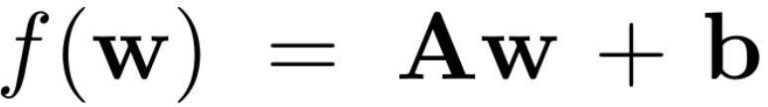
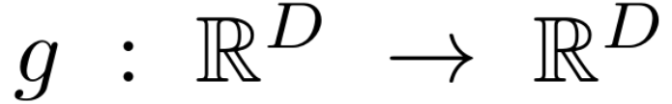
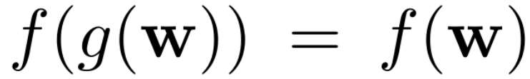
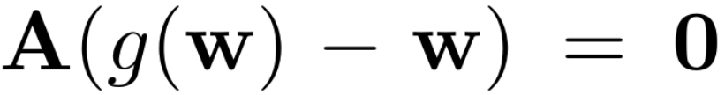

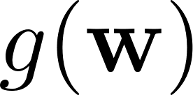

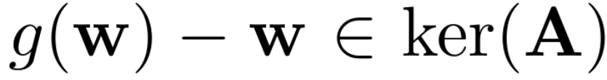
Section 2: Reparameterisation of linear functions
Consider a linear function
and a reparameterisation such that
Then
So the direction of movement between and lies in the kernel/nullspace of

Slide 22
Section 2: Reparameterisation of linear functions
Consider a linear function
and a reparameterisation such that
Then
So the direction of movement between and lies in the kernel/nullspace of

Slide 23
Section 2: Reparameterisation of linear functions
Consider a linear function
and a reparameterisation such that
Then
So the direction of movement between and lies in the kernel/nullspace of

Slide 24

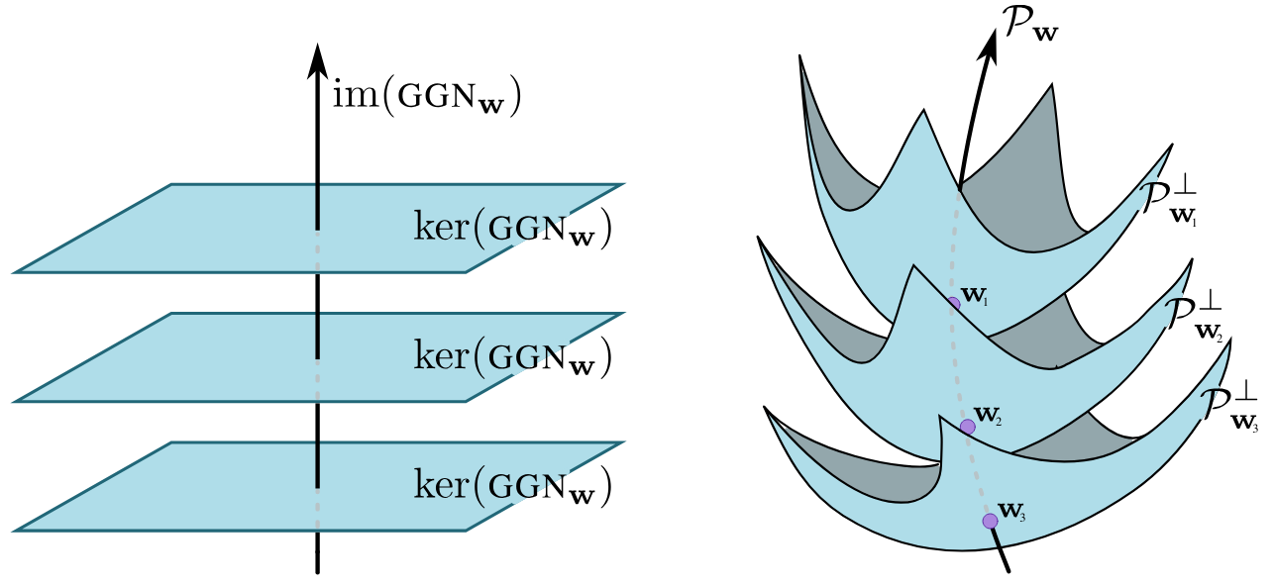
Find the kernel of the linearised NN (and avoid it!)
Because the GGN is a self-adjoint operator (positive semi-definite matrix)
spans to the effective parameters
(ideally we’d just explore this)
corresponds to the directions of reparameterisation
Notes:
When they say “Hence, the linear function cannot be reparametrized if we restrict ourselves to the non-kernel subspace of the input space or if A has a trivial kernel” near the bottom of page 3, they mean something like “when we move from a parameterisation, w, to a new parameterisation, w_new, we can check if the two parameterisations are identical if the direction of movement (w_new - w) lies in the kernel, i.e. w-w_new \in ker(A)”

Slide 25
Find the kernel of the linearised NN (and avoid it!)
Because the GGN is a self-adjoint operator (positive semi-definite matrix)
spans to the effective parameters
(ideally we’d just explore this)
corresponds to the directions of reparameterisation
Notes:
When they say “Hence, the linear function cannot be reparametrized if we restrict ourselves to the non-kernel subspace of the input space or if A has a trivial kernel” near the bottom of page 3, they mean something like “when we move from a parameterisation, w, to a new parameterisation, w_new, we can check if the two parameterisations are identical if the direction of movement (w_new - w) lies in the kernel, i.e. w-w_new \in ker(A)”

Slide 26
Find the kernel of the linearised NN (and avoid it!)
Because the GGN is a self-adjoint operator (positive semi-definite matrix)
spans to the effective parameters
(ideally we’d just explore this)
corresponds to the directions of reparameterisation
Notes:
When they say “Hence, the linear function cannot be reparametrized if we restrict ourselves to the non-kernel subspace of the input space or if A has a trivial kernel” near the bottom of page 3, they mean something like “when we move from a parameterisation, w, to a new parameterisation, w_new, we can check if the two parameterisations are identical if the direction of movement (w_new - w) lies in the kernel, i.e. w-w_new \in ker(A)”

Slide 27
Find the kernel of the linearised NN (and avoid it!)
Because the GGN is a self-adjoint operator (positive semi-definite matrix)
spans to the effective parameters
(ideally we’d just explore this)
corresponds to the directions of reparameterisation
Notes:
When they say “Hence, the linear function cannot be reparametrized if we restrict ourselves to the non-kernel subspace of the input space or if A has a trivial kernel” near the bottom of page 3, they mean something like “when we move from a parameterisation, w, to a new parameterisation, w_new, we can check if the two parameterisations are identical if the direction of movement (w_new - w) lies in the kernel, i.e. w-w_new \in ker(A)”

Slide 28
Find the kernel of the linearised NN (and avoid it!)
Because the GGN is a self-adjoint operator (positive semi-definite matrix)
spans to the effective parameters
(ideally we’d just explore this)
corresponds to the directions of reparameterisation
Notes:
When they say “Hence, the linear function cannot be reparametrized if we restrict ourselves to the non-kernel subspace of the input space or if A has a trivial kernel” near the bottom of page 3, they mean something like “when we move from a parameterisation, w, to a new parameterisation, w_new, we can check if the two parameterisations are identical if the direction of movement (w_new - w) lies in the kernel, i.e. w-w_new \in ker(A)”

Slide 29
Find the kernel of the linearised NN (and avoid it!)
Because the GGN is a self-adjoint operator (positive semi-definite matrix)
spans to the effective parameters
(ideally we’d just explore this)
corresponds to the directions of reparameterisation
Notes:
When they say “Hence, the linear function cannot be reparametrized if we restrict ourselves to the non-kernel subspace of the input space or if A has a trivial kernel” near the bottom of page 3, they mean something like “when we move from a parameterisation, w, to a new parameterisation, w_new, we can check if the two parameterisations are identical if the direction of movement (w_new - w) lies in the kernel, i.e. w-w_new \in ker(A)”

Slide 30
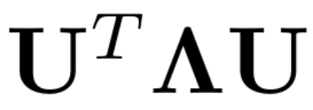
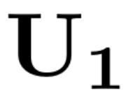
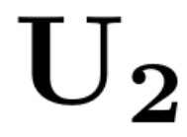
Laplace samples can be decomposed into image and kernel contributions
Let be the eigendecomposition of with and corresponding to non-zero and zero eigenvalues respectively
So any Laplace sample can be written
(Note that all probability mass in the kernel comes from the prior)

Slide 31
Laplace samples can be decomposed into image and kernel contributions
Let be the eigendecomposition of with and corresponding to non-zero and zero eigenvalues respectively
So any Laplace sample can be written
(Note that all probability mass in the kernel comes from the prior)

Slide 32
Laplace samples can be decomposed into image and kernel contributions
Let be the eigendecomposition of with and corresponding to non-zero and zero eigenvalues respectively
So any Laplace sample can be written
(Note that all probability mass in the kernel comes from the prior)

Slide 33
Laplace samples can be decomposed into image and kernel contributions
Let be the eigendecomposition of with and corresponding to non-zero and zero eigenvalues respectively
So any Laplace sample can be written
(Note that all probability mass in the kernel comes from the prior)

Slide 34
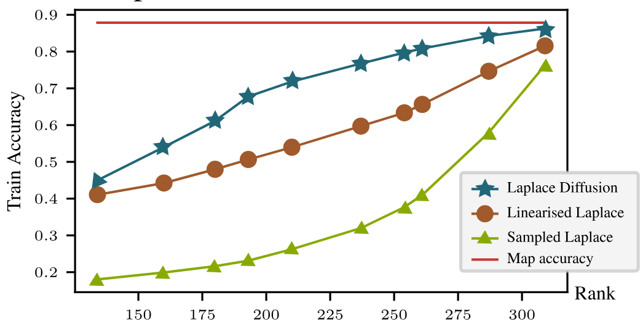

Linearised laplace automatically ignores
It doesn’t matter which reparameterisation gets sampled if your model is linear!
Regular Laplace doesn’t ignore because the kernel doesn’t correspond to reparameterisations
Adds ‘incorrect’ degrees of freedom to the approx. post.
This suggests that if is small (i.e. has a high rank) then regular Laplace should perform similarly to linearised Laplace
Small CNN on MNIST so GGN can be computed exactly – (rank increases with more data if we keep the same number of parameters)

Slide 35
Linearised laplace automatically ignores
It doesn’t matter which reparameterisation gets sampled if your model is linear!
Regular Laplace doesn’t ignore because the kernel doesn’t correspond to reparameterisations
Adds ‘incorrect’ degrees of freedom to the approx. post.
This suggests that if is small (i.e. has a high rank) then regular Laplace should perform similarly to linearised Laplace
Small CNN on MNIST so GGN can be computed exactly – (rank increases with more data if we keep the same number of parameters)

Slide 36
Linearised laplace automatically ignores
It doesn’t matter which reparameterisation gets sampled if your model is linear!
Regular Laplace doesn’t ignore because the kernel doesn’t correspond to reparameterisations
Adds ‘incorrect’ degrees of freedom to the approx. post.
This suggests that if is small (i.e. has a high rank) then regular Laplace should perform similarly to linearised Laplace
Small CNN on MNIST so GGN can be computed exactly – (rank increases with more data if we keep the same number of parameters)

Slide 37
Linearised laplace automatically ignores
It doesn’t matter which reparameterisation gets sampled if your model is linear!
Regular Laplace doesn’t ignore because the kernel doesn’t correspond to reparameterisations
Adds ‘incorrect’ degrees of freedom to the approx. post.
This suggests that if is small (i.e. has a high rank) then regular Laplace should perform similarly to linearised Laplace
Small CNN on MNIST so GGN can be computed exactly – (rank increases with more data if we keep the same number of parameters)

Slide 38
Linearised laplace automatically ignores
It doesn’t matter which reparameterisation gets sampled if your model is linear!
Regular Laplace doesn’t ignore because the kernel doesn’t correspond to reparameterisations
Adds ‘incorrect’ degrees of freedom to the approx. post.
This suggests that if is small (i.e. has a high rank) then regular Laplace should perform similarly to linearised Laplace
Small CNN on MNIST so GGN can be computed exactly – (rank increases with more data if we keep the same number of parameters)

Slide 39
Linearised laplace automatically ignores
It doesn’t matter which reparameterisation gets sampled if your model is linear!
Regular Laplace doesn’t ignore because the kernel doesn’t correspond to reparameterisations
Adds ‘incorrect’ degrees of freedom to the approx. post.
This suggests that if is small (i.e. has a high rank) then regular Laplace should perform similarly to linearised Laplace
Small CNN on MNIST so GGN can be computed exactly – (rank increases with more data if we keep the same number of parameters)

Slide 40
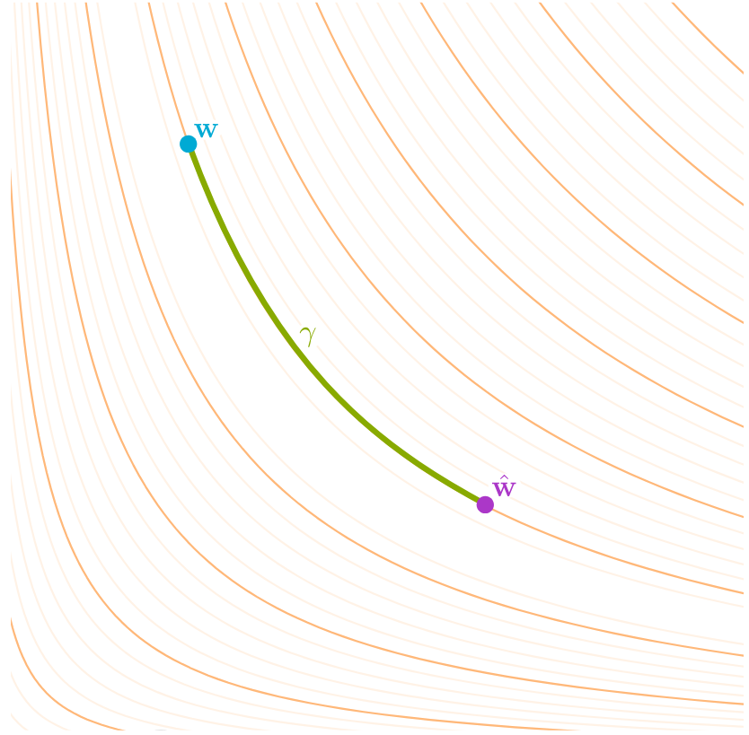
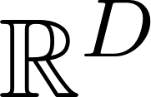


Section 3: Reparameterisation of NNs
They do the same analysis but for nonlinear models (e.g. regular NNs)
We can similarly decompose Laplace samples into a combination of two manifolds embedded in , and , which act like and
Then we can ignore the reparameterisation directions by only exploring (Laplace diffusion)

Slide 41
Section 3: Reparameterisation of NNs
They do the same analysis but for nonlinear models (e.g. regular NNs)
We can similarly decompose Laplace samples into a combination of two manifolds embedded in , and , which act like and
Then we can ignore the reparameterisation directions by only exploring (Laplace diffusion)

Slide 42
Section 3: Reparameterisation of NNs
They do the same analysis but for nonlinear models (e.g. regular NNs)
We can similarly decompose Laplace samples into a combination of two manifolds embedded in , and , which act like and
Then we can ignore the reparameterisation directions by only exploring (Laplace diffusion)

Slide 43
Section 3: Reparameterisation of NNs
They do the same analysis but for nonlinear models (e.g. regular NNs)
We can similarly decompose Laplace samples into a combination of two manifolds embedded in , and , which act like and
Then we can ignore the reparameterisation directions by only exploring (Laplace diffusion)

Slide 44



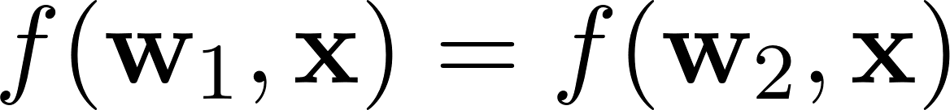
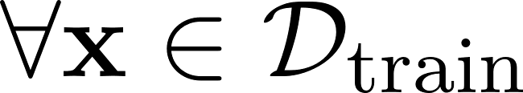

Define Effective Parameter-Space as a Quotient Group
iff there exists a smooth path between and such that
Then we define the effective parameter space as the quotient group
(i.e. only consider parameters that give us unique functions)

Slide 45
Define Effective Parameter-Space as a Quotient Group
iff there exists a smooth path between and such that
Then we define the effective parameter space as the quotient group
(i.e. only consider parameters that give us unique functions)

Slide 46
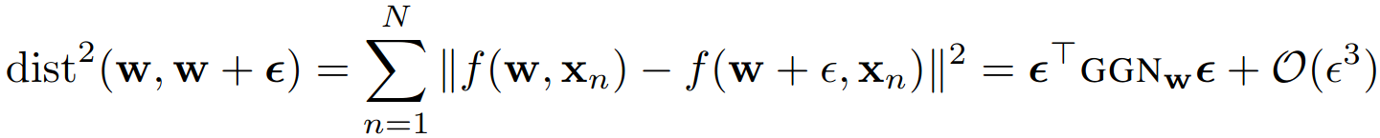
Define a Reparameterisation Distance and get a (Pseudo-)Riemannian manifold
We’d like to define a distance such that
So the GGN matrix infinitesimally defines an inner product, a (pseudo-)Riemannian metric!
NOTE:
GGN is rank-deficient (hence pseudo-riemannian)
w_1 ~ w_2 doesn’t then necessarily mean GGN_w_1 = GGN_w_2 ((pseudo-) metric might be different based on your Laplace centre/mode (... but infinitesimally that doesn’t matter too much))

Slide 47
Define a Reparameterisation Distance and get a (Pseudo-)Riemannian manifold
We’d like to define a distance such that
So the GGN matrix infinitesimally defines an inner product, a (pseudo-)Riemannian metric!
NOTE:
GGN is rank-deficient (hence pseudo-riemannian)
w_1 ~ w_2 doesn’t then necessarily mean GGN_w_1 = GGN_w_2 ((pseudo-) metric might be different based on your Laplace centre/mode (... but infinitesimally that doesn’t matter too much))

Slide 48
Define a Reparameterisation Distance and get a (Pseudo-)Riemannian manifold
We’d like to define a distance such that
So the GGN matrix infinitesimally defines an inner product, a (pseudo-)Riemannian metric!
NOTE:
GGN is rank-deficient (hence pseudo-riemannian)
w_1 ~ w_2 doesn’t then necessarily mean GGN_w_1 = GGN_w_2 ((pseudo-) metric might be different based on your Laplace centre/mode (... but infinitesimally that doesn’t matter too much))

Slide 49
Define a Reparameterisation Distance and get a (Pseudo-)Riemannian manifold
We’d like to define a distance such that
So the GGN matrix infinitesimally defines an inner product, a (pseudo-)Riemannian metric!
NOTE:
GGN is rank-deficient (hence pseudo-riemannian)
w_1 ~ w_2 doesn’t then necessarily mean GGN_w_1 = GGN_w_2 ((pseudo-) metric might be different based on your Laplace centre/mode (... but infinitesimally that doesn’t matter too much))

Slide 50

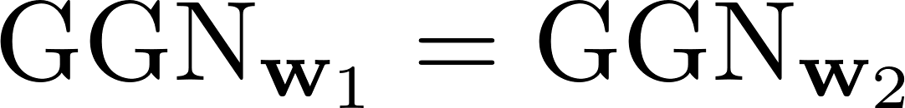
Define a Reparameterisation Distance and get a (Pseudo-)Riemannian manifold
We’d like to define a distance such that
So the GGN matrix infinitesimally defines an inner product, a (pseudo-)Riemannian metric!
NOTE:
GGN is rank-deficient (hence pseudo-riemannian)
doesn’t then necessarily mean (pseudo-metric might be different based on your Laplace centre/mode (... but infinitesimally that doesn’t matter too much))

Slide 51

Equivalence of the manifold and the quotient group
(Basically, using the tangent space of the GGN gives us a path along the homotopies in the equivalence classes.)
Why do we care? Answer: Riemannian diffusion.
We can run a Markov chain to give us samples from the Riemannian manifold
Problem: is only pseudo-Riemannian (GGN is rank-deficient)

Slide 52
Equivalence of the manifold and the quotient group
(Basically, using the tangent space of the GGN gives us a path along the homotopies in the equivalence classes.)
Why do we care? Answer: Riemannian diffusion.
We can run a Markov chain to give us samples from the Riemannian manifold
Problem: is only pseudo-Riemannian (GGN is rank-deficient)

Slide 53
Equivalence of the manifold and the quotient group
(Basically, using the tangent space of the GGN gives us a path along the homotopies in the equivalence classes.)
Why do we care? Answer: Riemannian diffusion.
We can run a Markov chain to give us samples from the Riemannian manifold
Problem: is only pseudo-Riemannian (GGN is rank-deficient)

Slide 54
Equivalence of the manifold and the quotient group
(Basically, using the tangent space of the GGN gives us a path along the homotopies in the equivalence classes.)
Why do we care? Answer: Riemannian diffusion.
We can run a Markov chain to give us samples from the Riemannian manifold
Problem: is only pseudo-Riemannian (GGN is rank-deficient)

Slide 55
Equivalence of the manifold and the quotient group
(Basically, using the tangent space of the GGN gives us a path along the homotopies in the equivalence classes.)
Why do we care? Answer: Riemannian diffusion.
We can run a Markov chain to give us samples from the Riemannian manifold
Problem: is only pseudo-Riemannian (GGN is rank-deficient)

Slide 56
Equivalence of the manifold and the quotient group
(Basically, using the tangent space of the GGN gives us a path along the homotopies in the equivalence classes.)
Why do we care? Answer: Riemannian diffusion.
We can run a Markov chain to give us samples from the Riemannian manifold
Problem: is only pseudo-Riemannian (GGN is rank-deficient)

Slide 57



Define two Riemannian manifolds which act as and
where
Never intersects the same equivalence class more than once (at least locally)
Like the effective parameter manifold (but actually Riemannian)
2. where
Entirely contained in the same equivalence class
So contains only functions which are identical on the training set

Slide 58
Define two Riemannian manifolds which act as and
where
Never intersects the same equivalence class more than once (at least locally)
Like the effective parameter manifold (but actually Riemannian)
2. where
Entirely contained in the same equivalence class
So contains only functions which are identical on the training set

Slide 59
Define two Riemannian manifolds which act as and
where
Never intersects the same equivalence class more than once (at least locally)
Like the effective parameter manifold (but actually Riemannian)
2. where
Entirely contained in the same equivalence class
So contains only functions which are identical on the training set

Slide 60
Define two Riemannian manifolds which act as and
where
Never intersects the same equivalence class more than once (at least locally)
Like the effective parameter manifold (but actually Riemannian)
2. where
Entirely contained in the same equivalence class
So contains only functions which are identical on the training set

Slide 61
Define two Riemannian manifolds which act as and
where
Never intersects the same equivalence class more than once (at least locally)
Like the effective parameter manifold (but actually Riemannian)
2. where
Entirely contained in the same equivalence class
So contains only functions which are identical on the training set

Slide 62
Define two Riemannian manifolds which act as and
where
Never intersects the same equivalence class more than once (at least locally)
Like the effective parameter manifold (but actually Riemannian)
2. where
Entirely contained in the same equivalence class
So contains only functions which are identical on the training set

Slide 63
Define two Riemannian manifolds which act as and
where
Never intersects the same equivalence class more than once (at least locally)
Like the effective parameter manifold (but actually Riemannian)
2. where
Entirely contained in the same equivalence class
So contains only functions which are identical on the training set

Slide 64

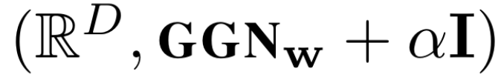

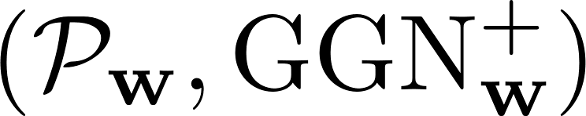
Section 4: Diffusion on various manifolds
0. Effective-parameter is only pseudo-Riemannian
Laplace Approximation
Kernel manifold (never underfits)
Non-kernel-parameter manifold, i.e. “Laplace Diffusion”

Slide 65
Section 4: Diffusion on various manifolds
0. Effective-parameter is only pseudo-Riemannian
Laplace Approximation
Kernel manifold (never underfits)
Non-kernel-parameter manifold, i.e. “Laplace Diffusion”

Slide 66
Section 4: Diffusion on various manifolds
0. Effective-parameter is only pseudo-Riemannian
Laplace Approximation
Kernel manifold (never underfits)
Non-kernel-parameter manifold, i.e. “Laplace Diffusion”

Slide 67
Section 4: Diffusion on various manifolds
0. Effective-parameter is only pseudo-Riemannian
Laplace Approximation
Kernel manifold (“never underfits”)
Non-kernel-parameter manifold, i.e. “Laplace Diffusion”

Slide 68
Section 4: Diffusion on various manifolds
0. Effective-parameter is only pseudo-Riemannian
Laplace Approximation
Kernel manifold (“never underfits”)
Non-kernel-parameter manifold, i.e. “Laplace Diffusion”

Slide 69
Section 4: Diffusion on various manifolds
0. Effective-parameter is only pseudo-Riemannian
Laplace Approximation
Kernel manifold (“never underfits”)
Non-kernel-parameter manifold, i.e. “Laplace Diffusion”
4. Alternate between the two

Slide 70
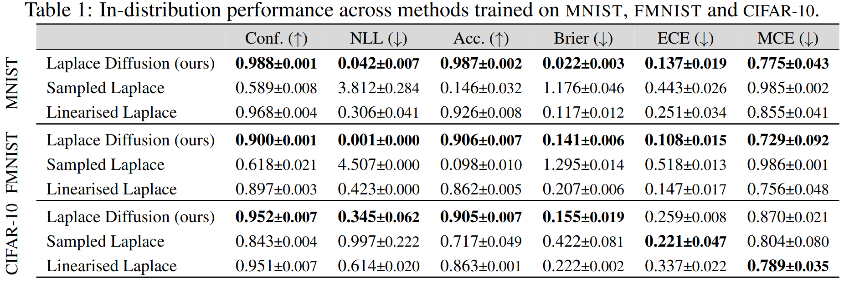
Results

Slide 71
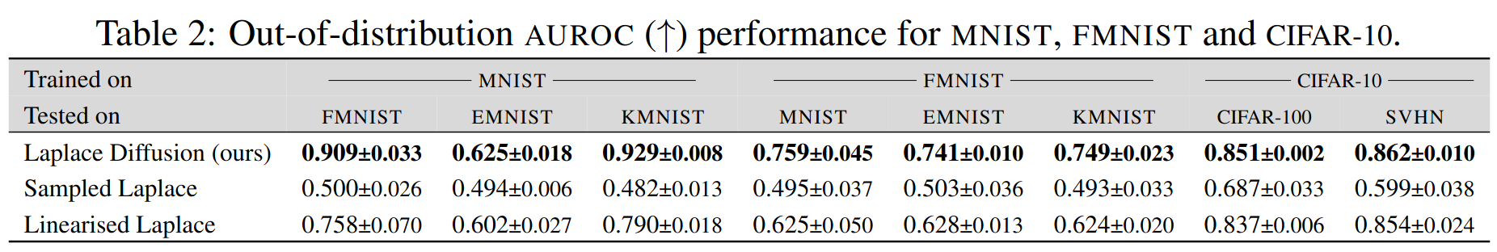
Results

Slide 72
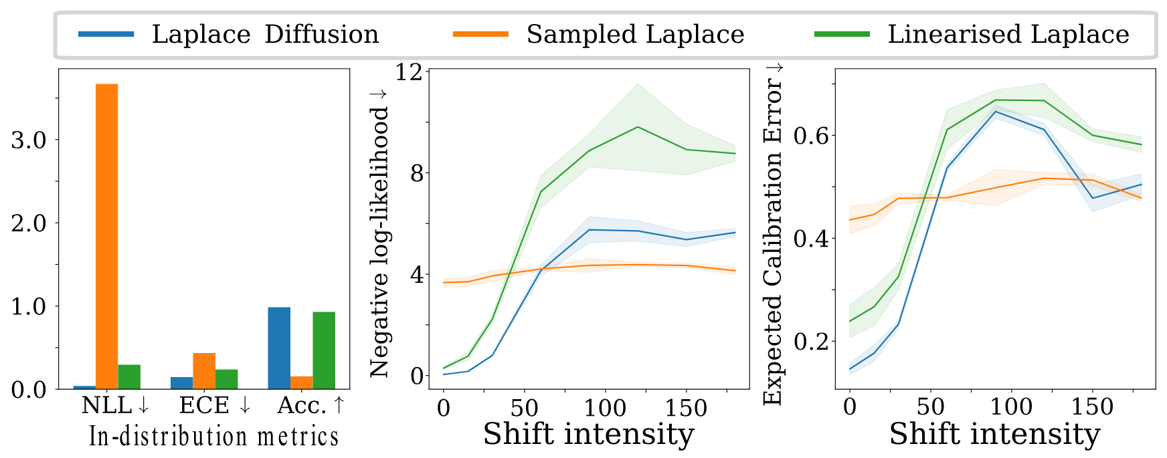
Rotated MNIST (shift = rotation angle)

Slide 73
Summary
Linearised Laplace works better than full Laplace because it implicitly ignores the reparameterisation issues of BNNs
Their new method (Laplace diffusion) also tries to remove those reparameterisation issues (but is significantly more complicated)
In practice, we often use an approximation of the GGN (e.g. KFAC), which would break the motivation behind their new method

Slide 74
Summary
Linearised Laplace works better than full Laplace because it implicitly ignores the reparameterisation issues of BNNs
Their new method (Laplace diffusion) also tries to remove those reparameterisation issues (but is significantly more complicated)
In practice, we often use an approximation of the GGN (e.g. KFAC), which would break the motivation behind their new method

Slide 75
Summary
Linearised Laplace works better than full Laplace because it implicitly ignores the reparameterisation issues of BNNs
Their new method (Laplace diffusion) also tries to remove those reparameterisation issues (but is significantly more complicated)
In practice, we often use an approximation of the GGN (e.g. KFAC), which would break the motivation behind their new method

Slide 76
Links
Paper: https://arxiv.org/pdf/2406.03334
Slides from a talk by one of the authors: https://www2.compute.dtu.dk/~sohau//talks/2024_MTNS/
Immer et al. (2021): “ Improving predictions of Bayesian neural nets via local linearization,” Alexander Immer, Maciej Korzepa, Matthias Bauer. Proceedings of The 24th International Conference on Artificial Intelligence and Statistics, PMLR 130:703-711, 2021. https://proceedings.mlr.press/v130/immer21a.html

Slide 77
pics

Slide 78
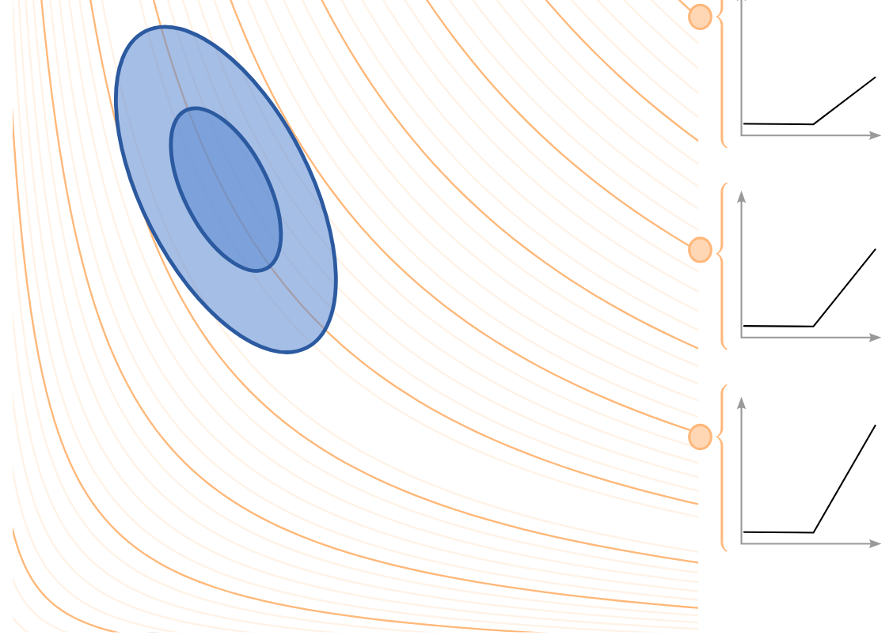
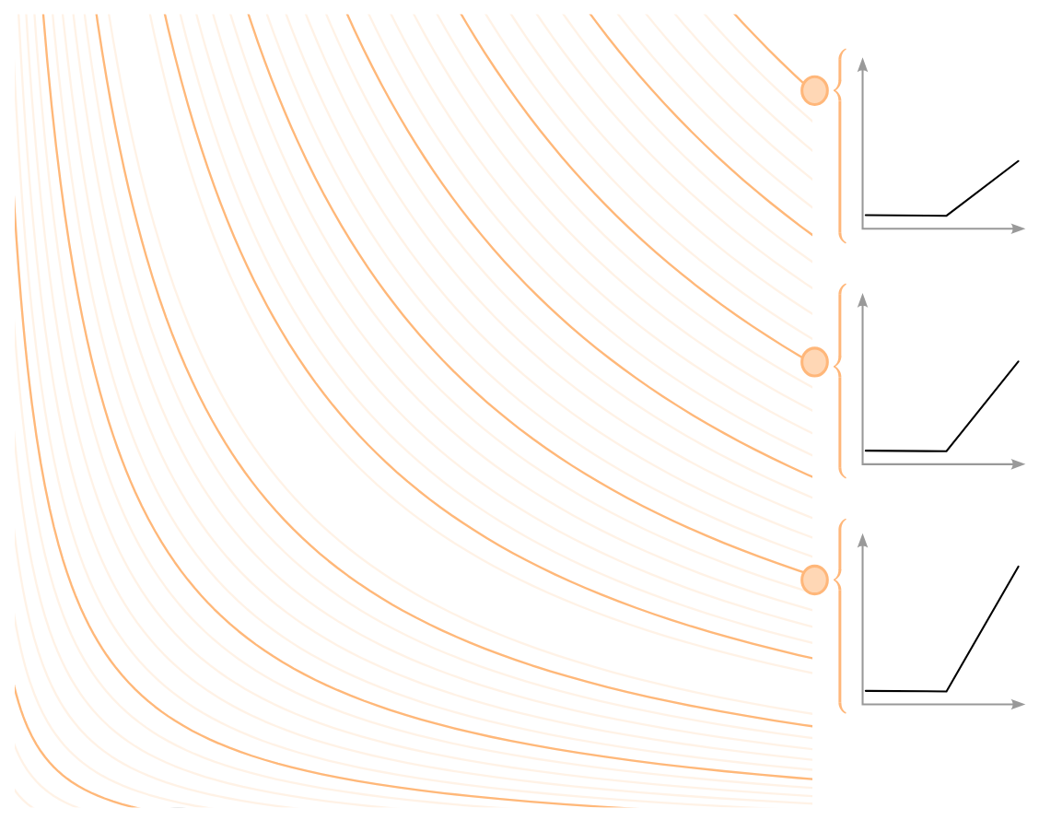
From slides

Slide 79
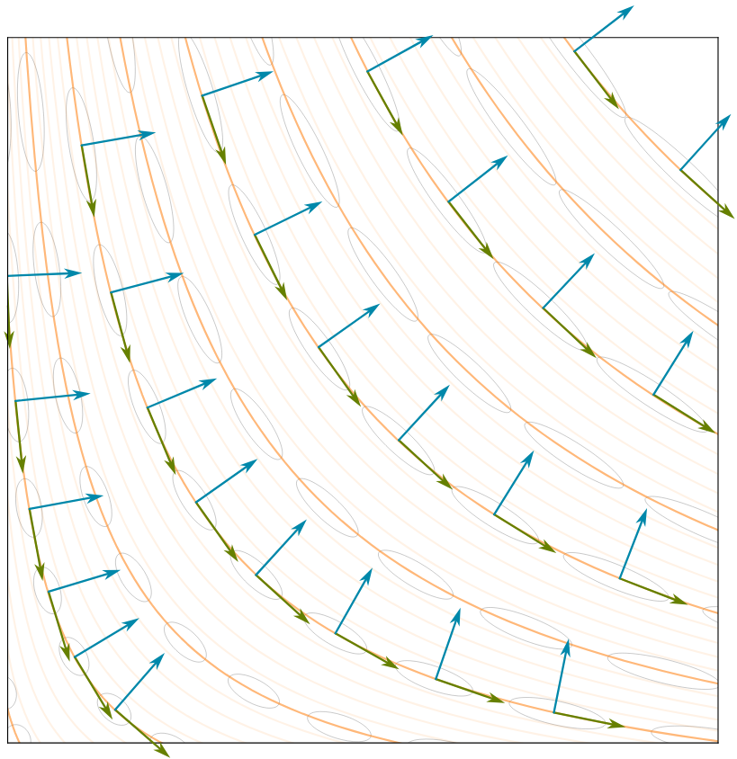
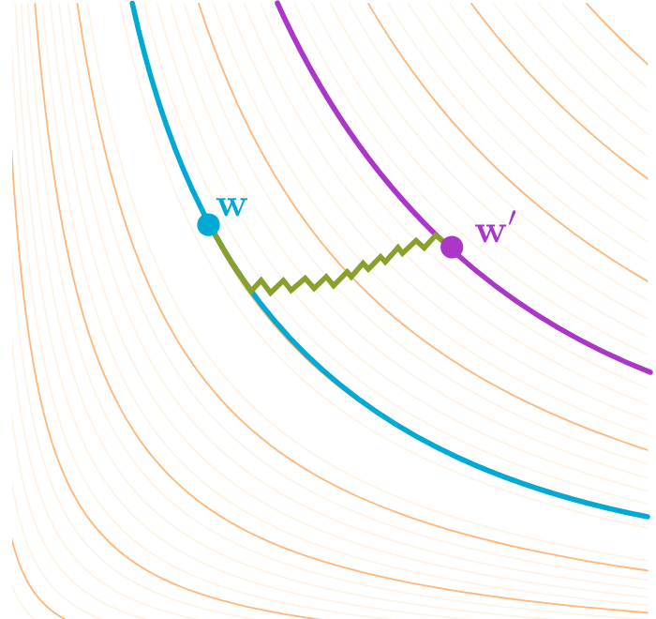

Slide 80
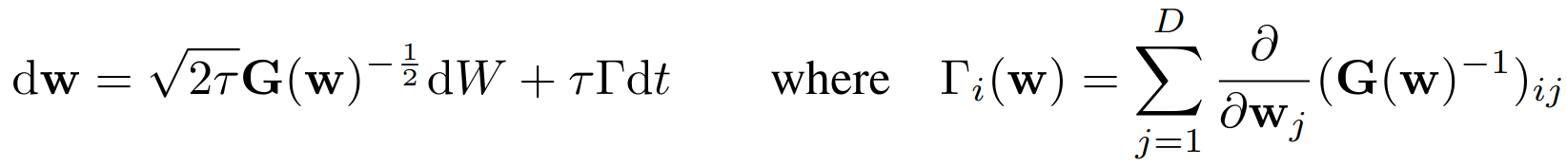
Section 4: They do diffusion

